Slide 1
Using Language Processing to Find Fake Amazon Reviews
Joseph Klafka, Timmy Li, Michelle Liang, Jon Pekarek

Slide 2
Description of the Dataset
18 GB JSON file that contained ~83 million Amazon reviews across all product categories
The dataset gave us the reviewer ID, asin (ie. product ID), reviewer name, helpfulness rating, the review text, the overall rating score, and the summary of the review
Given that one of the later steps of our project would be looking at all possible pairs of reviews, we opted to use a sub-dataset of 94.4 MB that contained all reviews within the category of baby products (153,919 reviews)

Slide 3
Hypotheses Tested
How many reviews use similar words and phrases?
Are most similar reviews written for the same product?
Are similar reviews typically written by the same person?

Slide 4
Algorithms Used and Big Data Approaches
“Reverse Top-K”: instead of finding the Top-K words, we wanted to find the least occurring 60,000 words in the sub-dataset
Used MapReduce
Natural Language Processing Similarity Matrix:
Each row corresponded to a review and each column corresponded to a word in the vocabulary
Allowed us to directly compare the words used in the different reviews and how many time the word was used
MapReduce
Reverse Top-K
Look at each review to get counts
Create sparse matrix
Comparing all possible pairs
Count the number of pairs w/ matching product IDs and reviewer IDs below a certain threshold

Slide 5
Runtimes
Creating word dictionary: 1.5 - 2 hours
Creating sparse matrix: less than 1 hour
Creating pairings: 1 hour
Threshold comparisons: 2 hours

Slide 6
Other Big Data Techniques Used
Google Cloud Buckets
Auxiliary Files
Sparse Matrices

Slide 7
Challenges Faced
Large file storage - used buckets
Bucket access - used mapreduce credentials
Running code on 83 million reviews - used sub-dataset
Storing reviews word counts - used sparse matrix

Slide 8
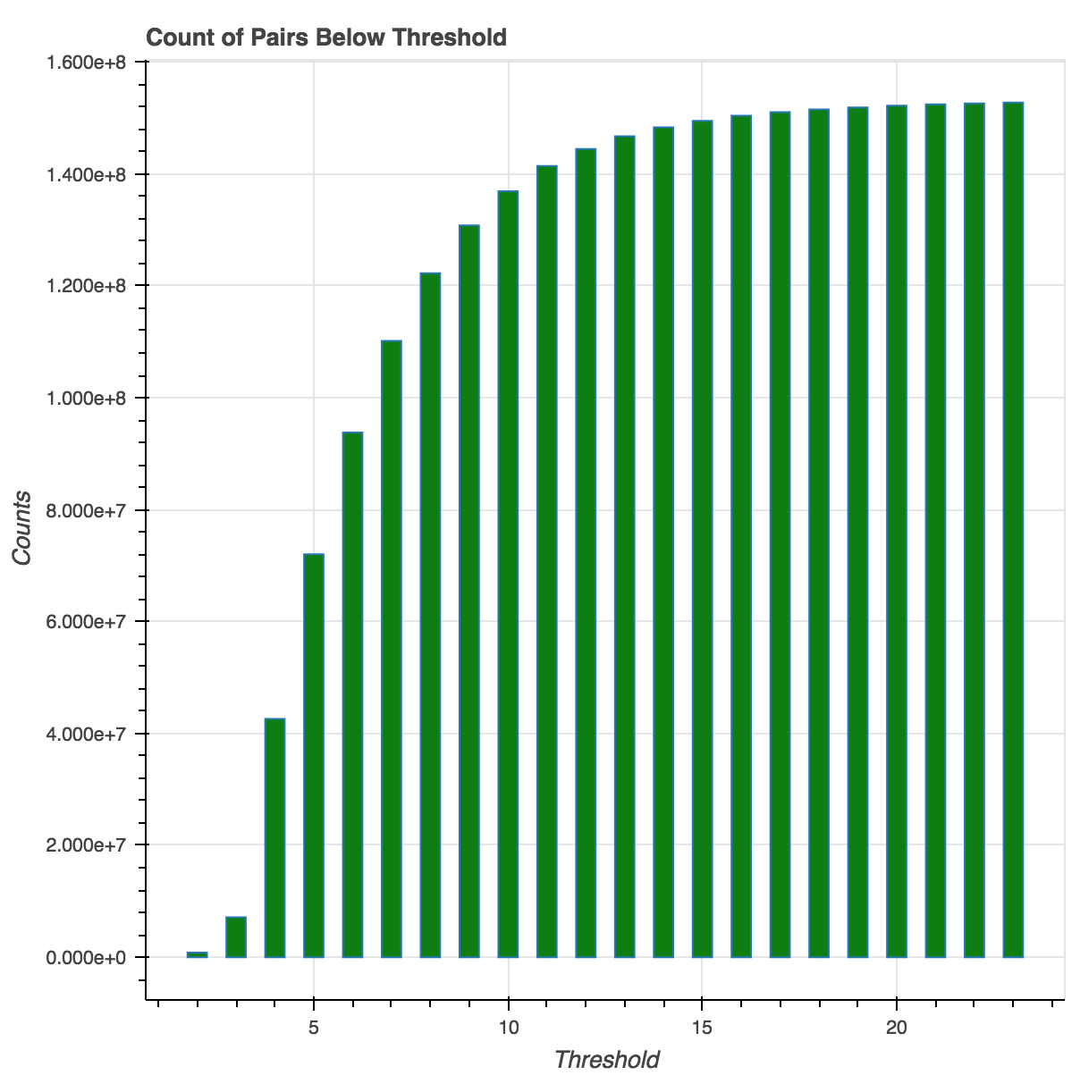
Results

Slide 9
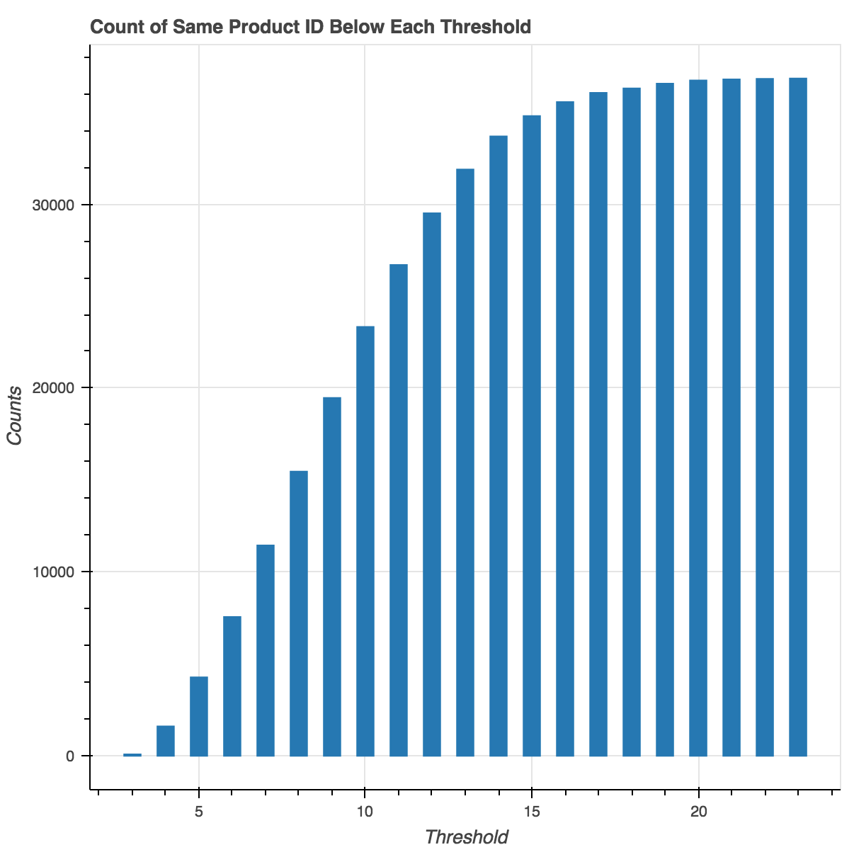

Slide 10
